Slide 1


HIVE
Nagarjuna K

Slide 2
Pre Requisites
Knowledge about SQL
Might help

Slide 3
History
Built by Jeff’s team at FaceBook
A tool built for data warehousing on top of hadoop

Slide 4

Why HIVE
huge volumes of data FB producing
burgeoning Social Network
How to analyze the data ?

Slide 5
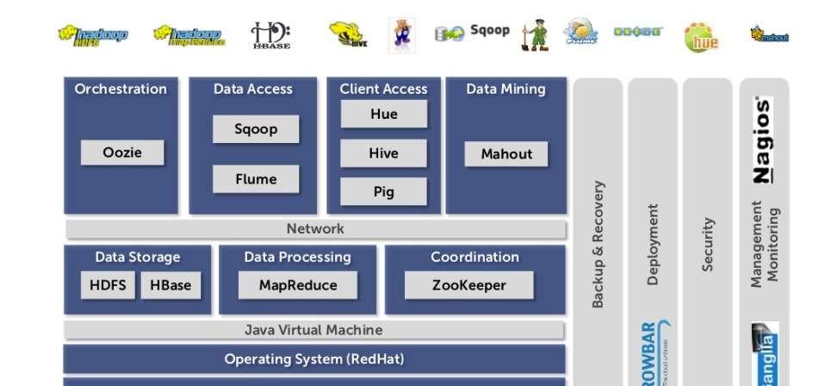
Hadoop EcoSystems

Slide 6
What is HIVE
Tools to enable easy data extract/transform/load (ETL)
A mechanism to impose structure on a variety of data formats
Access to files stored either directly in Apache HDFSTM or in other data storage systems such as Apache HBaseTM
Query execution via MapReduce

Slide 7











Who are using HIVE

Slide 8
What is Hive For
What is hadoop for ?
&&
adhoc batch processing of data.

Slide 9
What is Hive not for
What is hadoop not for ?
real time data processing
row level updates

Slide 10
What hive values most
What Hadoop values most ?
scalability
extensibility (MapReduce and UDF/UDAF/UDTF)
fault tolerance
loose coupling(input formats)

Slide 11
Hive - Set Up
Setting Up hive
derby metastore

Slide 12
Configuration files
hive –site.xml
$HIVE_HOME/conf/hive-site.xml
Alternate way
hive --config /Users/tom/dev/hive-conf
You have two or more clusters
You alternate frequently

Slide 13
Hive Tables
Two types of tables
External Table
Table created on top of the existing data
delete the table ➔ data still persistent
Normal Table
Tables location is in hives default location
delete the table ➔ data gone

Slide 14
Hive Usage
shell
$HIVE_HOME/bin/hive

Slide 15
Hive Usage
describing a table
desc <table_Name>
Listing all the inbuilt functions
show functions;
Describing a function
desc function <function_name>

Slide 16
Create Table
Employee1 | Name 1 |Address1|Phone 1
create external table (Key1 String, Name Strng,Address String, Phone String) row format delimited fields terminated by ‘|’ location ‘/….’;

Slide 17
Operations in hive
https://cwiki.apache.org/confluence/display/Hive/GettingStarted

